Slide 1
Geospatial Database For Shanghai
Presenter: Laha Ale
Instructor: Dr. Huang

Slide 2
Agenda
Motivation
Data Sources
Tools
Database
Modeling
Conclusion and Feature Work

Slide 3
Motivation
Census data
Mobile Network
Marketing
Recommendation
Services
Infrastructure

Slide 4
Data Sources
2000 Shanghai County Population Census Data
2000 China Township Population Census Data
2000 China Grid Population Data
The Telecom Dataset

Slide 5
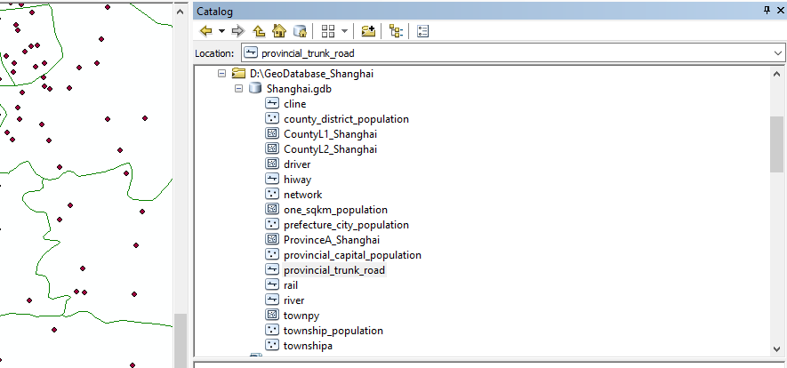
Geospatial Database

Slide 6
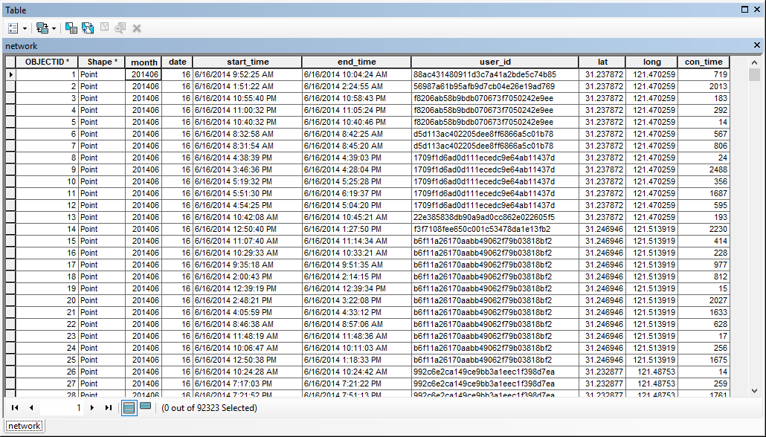
Point- Telecom datasets

Slide 7
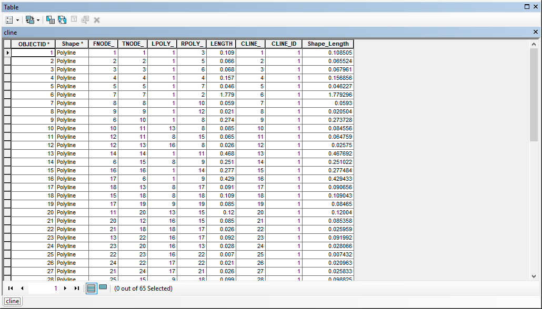
Line- County boundaries

Slide 8
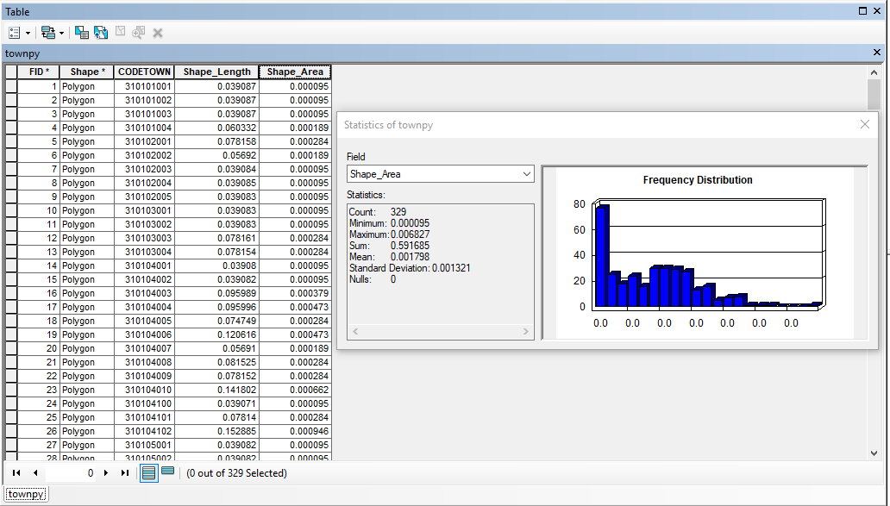
Polygon- Derived township boundaries

Slide 9
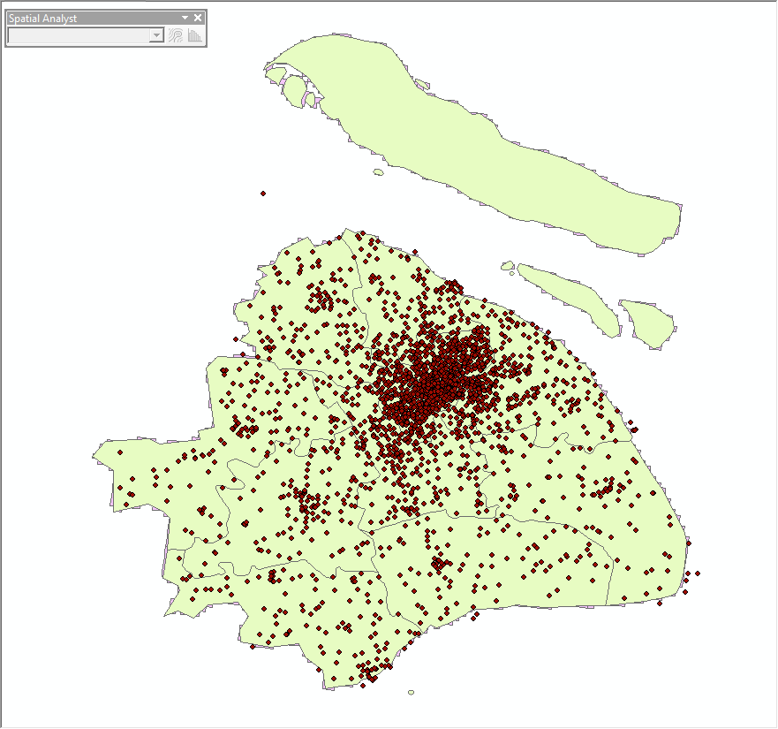
Feature Layer Example

Slide 10
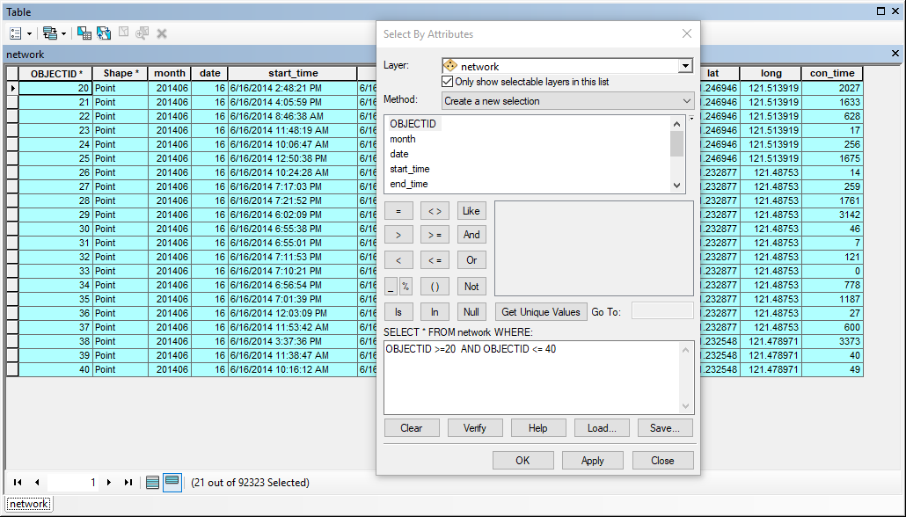
Query

Slide 11
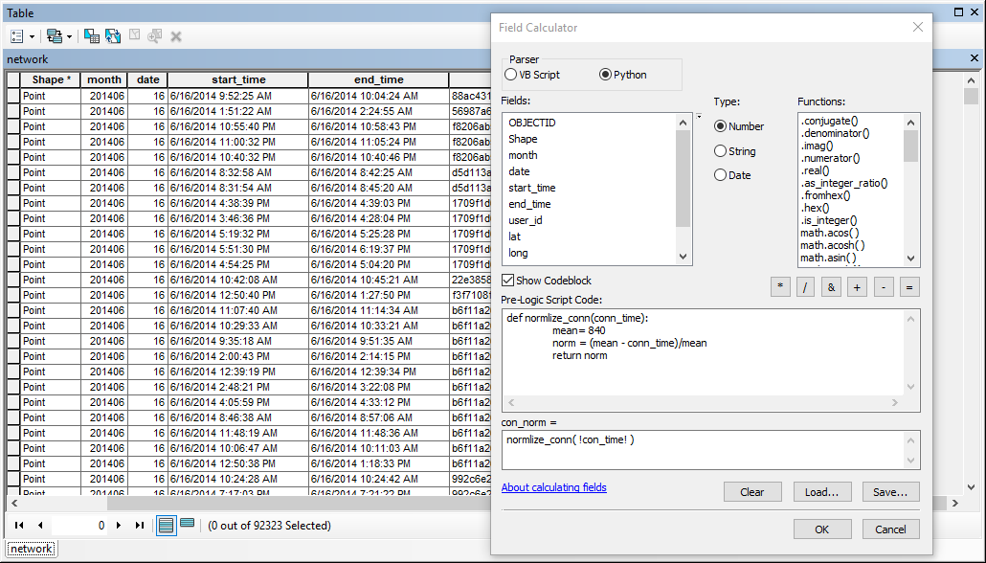
Field Calculator with Python

Slide 12
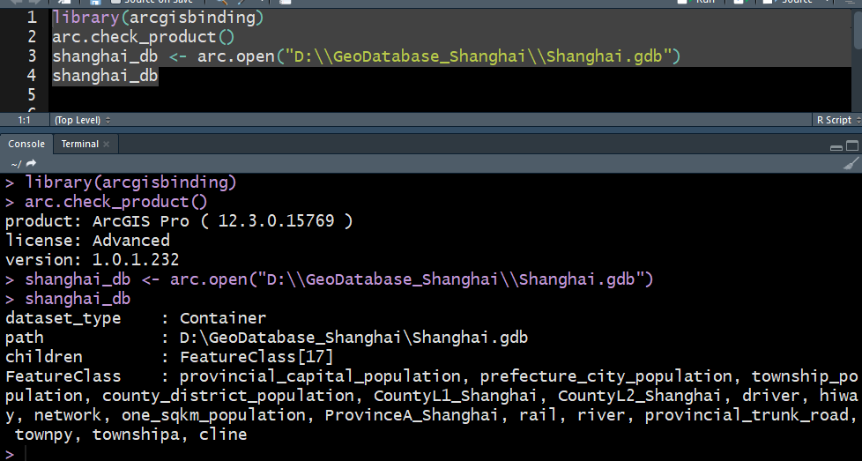
Read Database

Slide 13
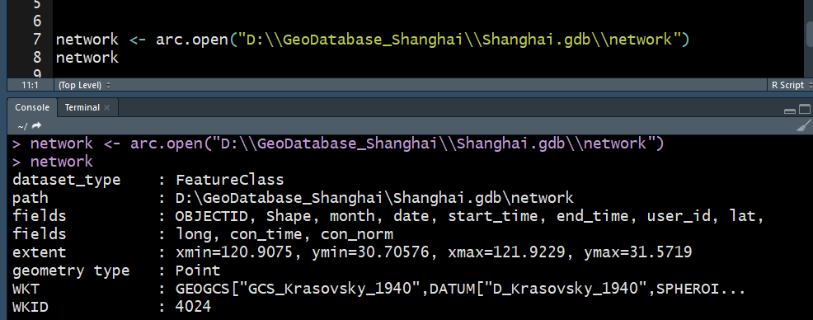
Read Feature Class

Slide 14
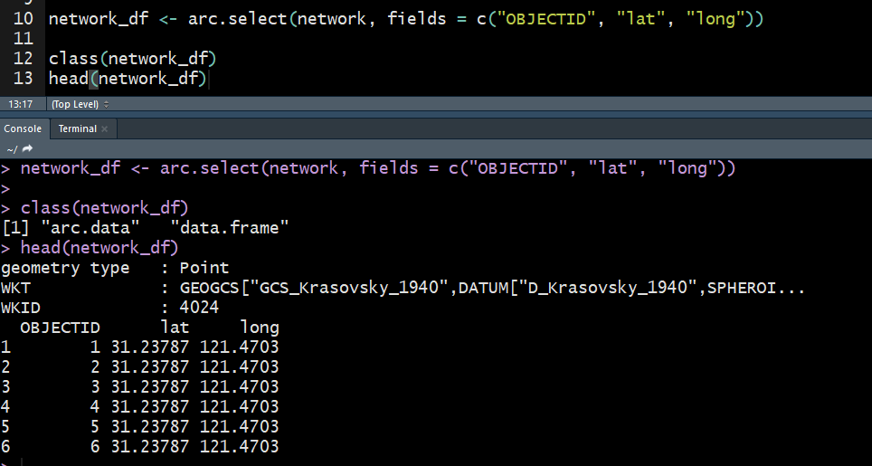
Query Feature Class

Slide 15
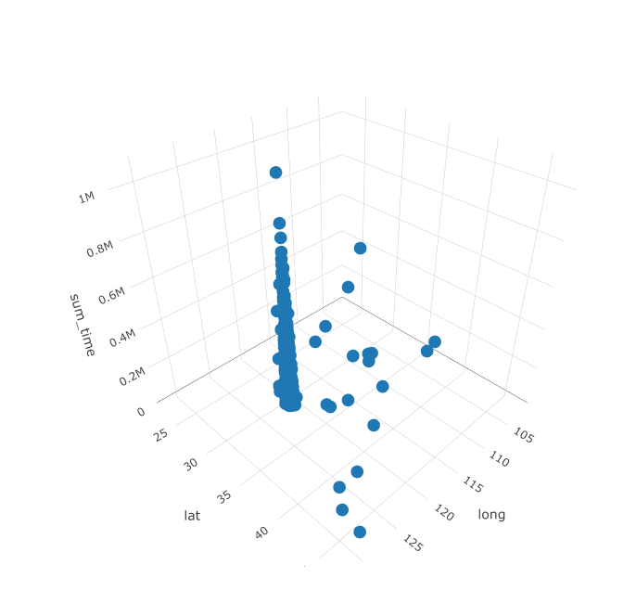
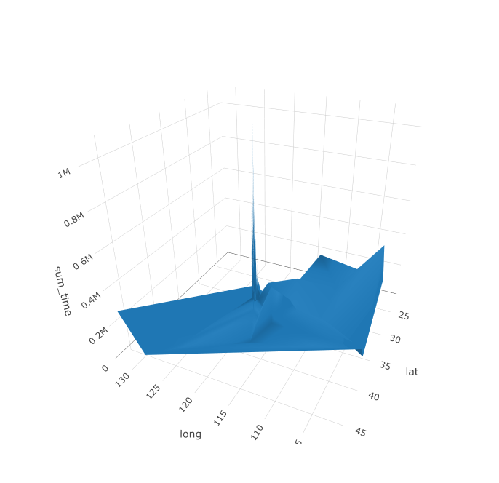
Data Clean

Slide 16
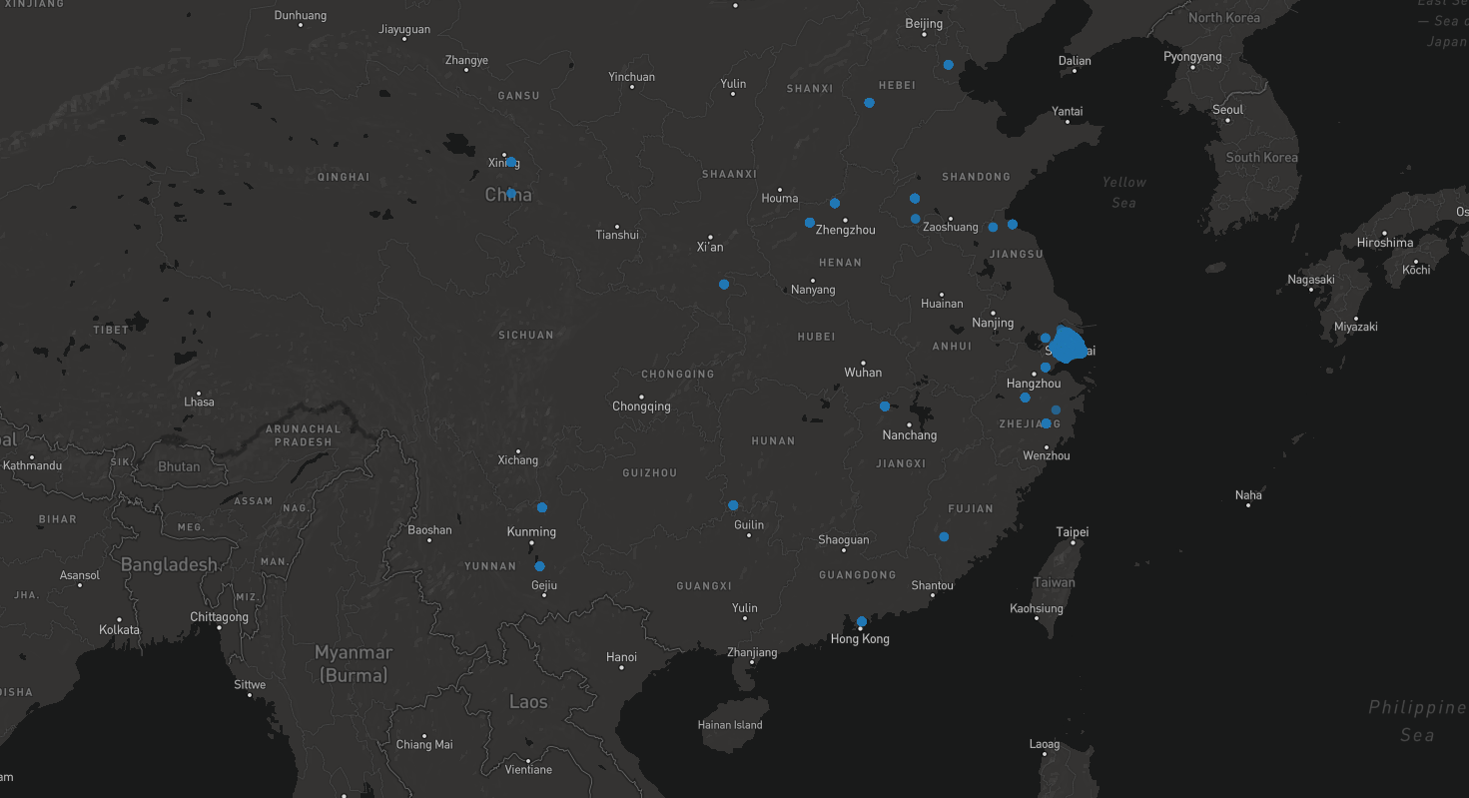
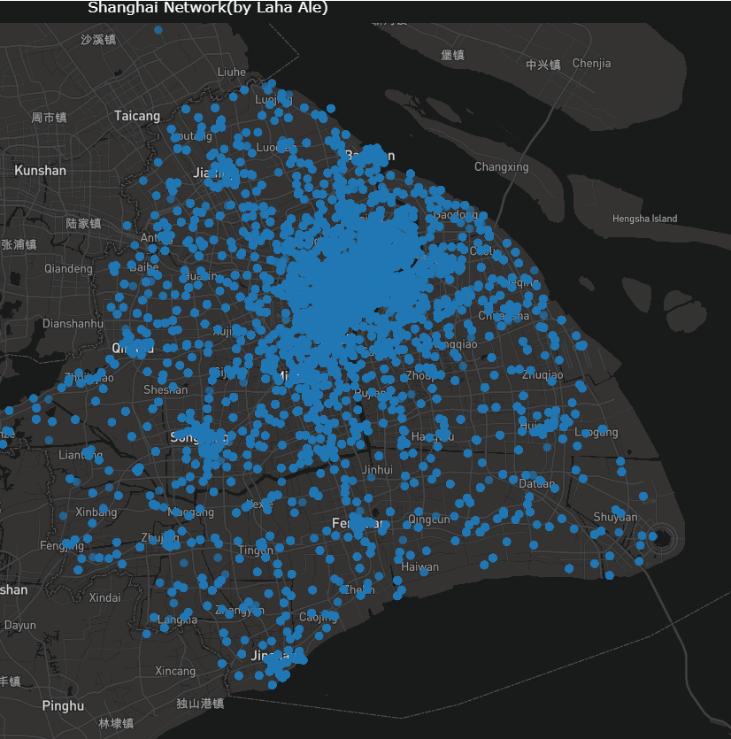
Data Exploratory

Slide 17
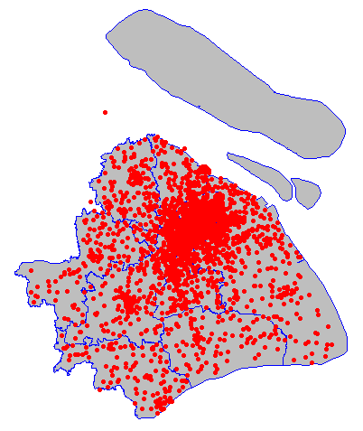
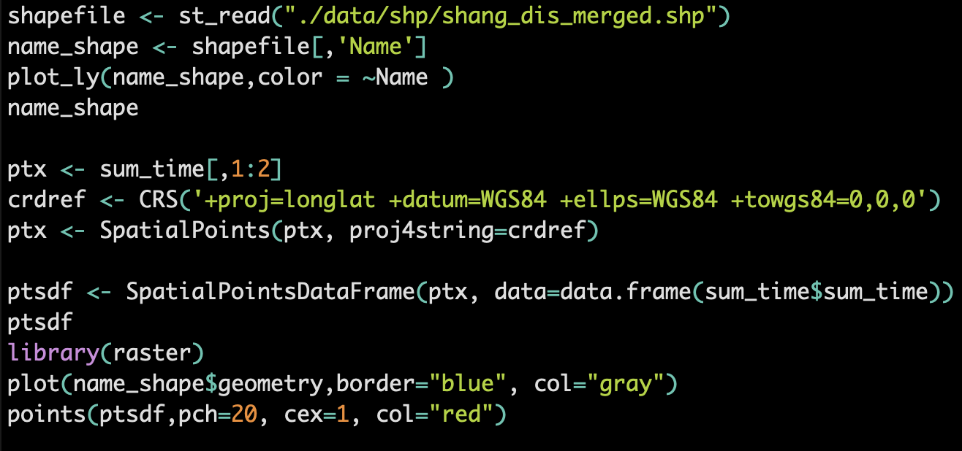
Remove outliers

Slide 18
Clean

Slide 19
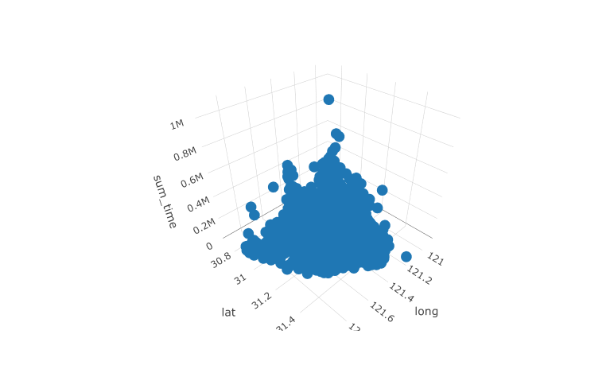
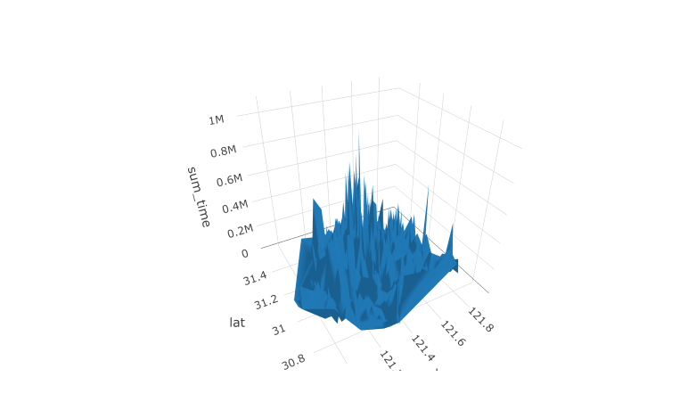
After Clean

Slide 20
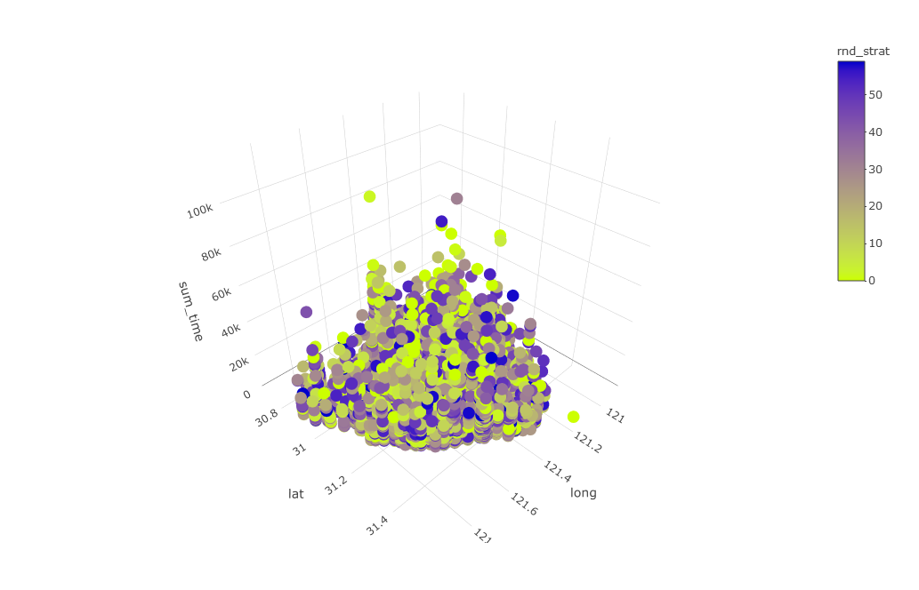
Grouped By Minutes

Slide 21
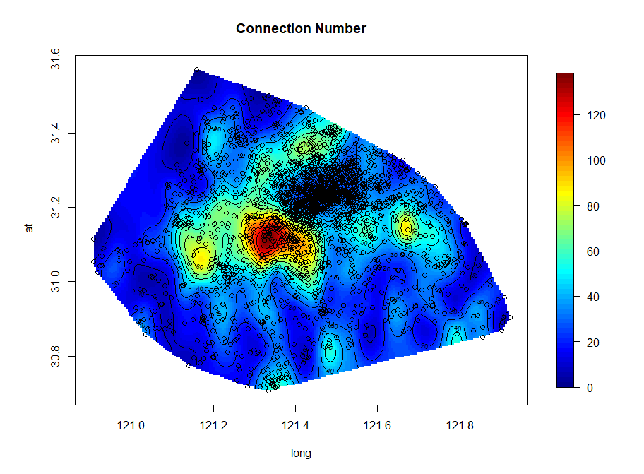
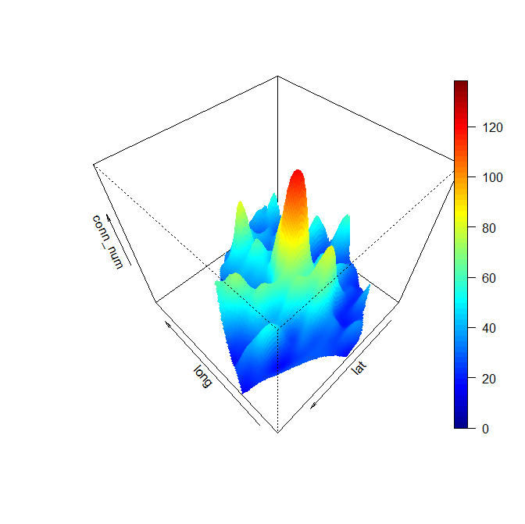
Interpolation

Slide 22
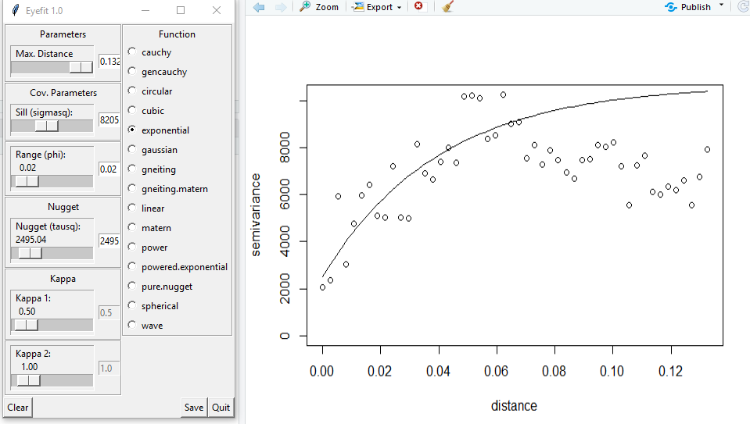
Variogram

Slide 23
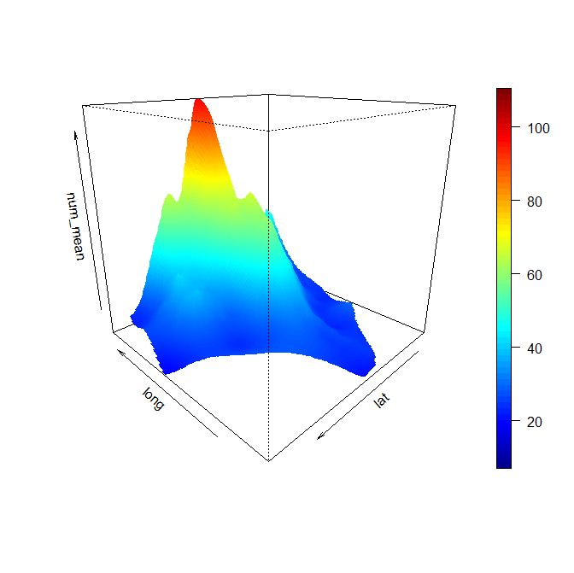
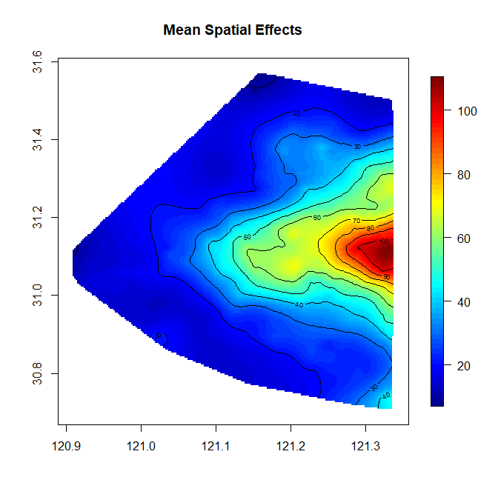
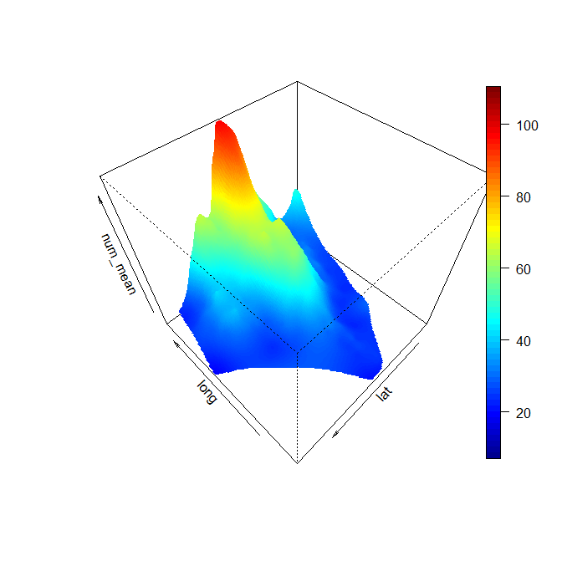
Bayesian-Mean

Slide 24
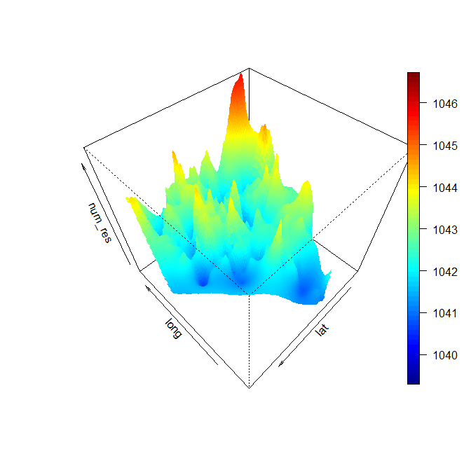
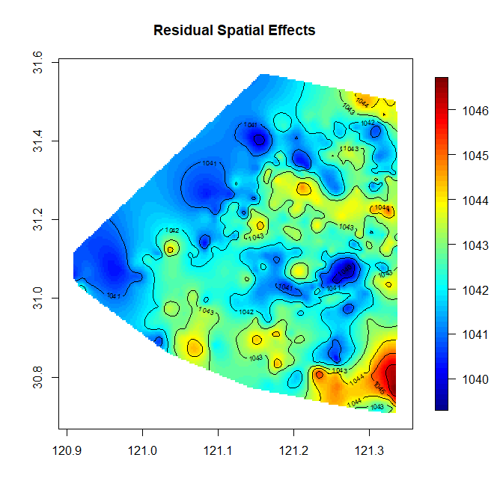
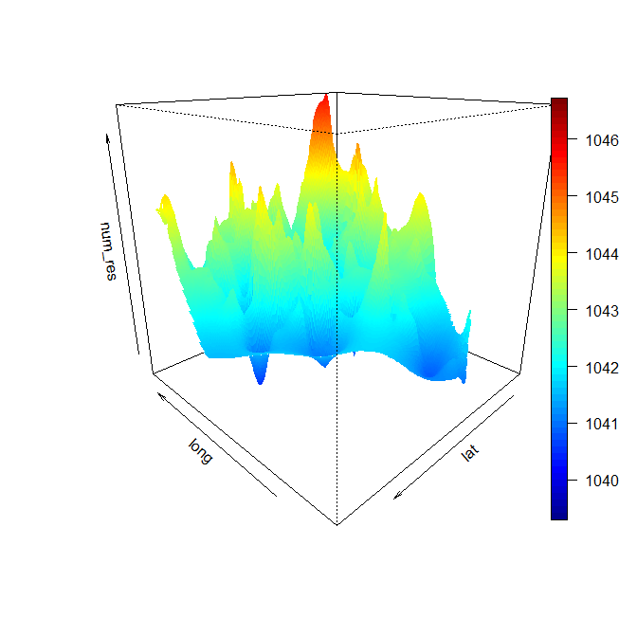
Bayesian-Residual

Slide 25
Future Work
Clean and Tidy the Database
Geospatial Data Mining
Spatial-Temporal Models

